Slide 1
ACM MM LGM3A’25
Dynamic Storytelling with Multimodal Synchronized Video Generation
Ye Zhiqiu

Slide 2
Introduction
Why it’s challenging
Users want coherent, engaging videos from concise input (e.g., one sentence).
Existing methods often:
Requires training (expensive, hard to scale).
Lack structured narrative across scenes.
Goal:
Turn a one-sentence input into a full, coherent, multimodal video (text + image + audio).
Key features:
Training-free hierarchical multi-agent pipeline for story & character generation.
Cross-modal alignment for text, visual, and audio coherence.
Stage-aware character grounding for consistent identity and appearance.
Notes:
ppl use ai in entertainment / educational / commercial settings. demand for video generation with coherency rises. Users often want to create engaging videos with just a short description, like a single sentence. However, existing approaches face two major problems: they usually require expensive training, which makes them hard to scale, their performance drop when use need to generate characters they are not trained on. and they often lack structured narrative with consistent characters across scenes.
Our goal is to take a one-sentence input and turn it into a fully coherent video with text, images, and audio. To achieve this, we designed a hierarchical multi-agent pipeline that generates stories and characters without any fine-tuning. The system also maintains cross-modal alignment between text, visuals, and audio, and it also features a character grounding module to ensure visual identity and stage-specific appearance across the story.

Slide 3
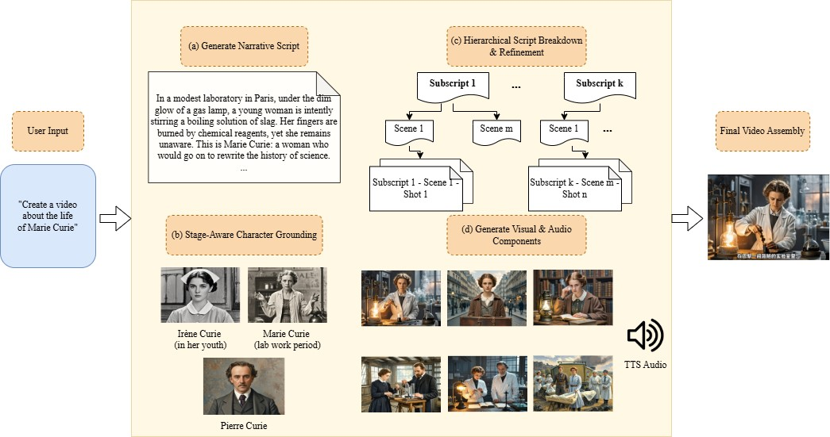
System Overview
Overall Input: Single-sentence user request. → Overall output: Video with narrative and audios.
4 modules:
Narrative Expansion
Character Grounding
Hierarchical Script Planning
Refinement & Multimodal Generation
Notes:
Here’s a high-level overview of our system. the overall inputs and outputs are straightforward. and there are 4 major modules to cooperatively handle the task.
The process starts with the user’s single-sentence input, which is expanded into a dynamic narrative by a large language model with the narrative expansion module. Then, the character grounding module identifies key characters and generates textual and visual references to ensure consistency.
Next, the system hierarchically decomposes the narrative into subscripts, scenes, and shots, during this process the number of shots is dynamically adjusted based on the narrative length to maintain smooth pacing. Finally, the refinement and generation module polish the textual prompts, synthesizes each modality. All these components are then assembled into the final synchronized video.
This pipeline is fully zero-shot and training-free, and each module contributes to maintaining a coherent story with consistent characters and cross-modal alignment.
Narrative Expansion: LLM generates a dynamic storyline from the input.
Character Grounding: Stage-aware character identification + visual references.
Hierarchical Script Planning: Decompose narrative into subscripts → scenes → shots.
Refinement & Multimodal Generation:
Refine shots for logical consistency.
Generate images, audio (TTS), and subtitles.
Video Assembly: Synchronize modalities into a coherent final video.

Slide 4
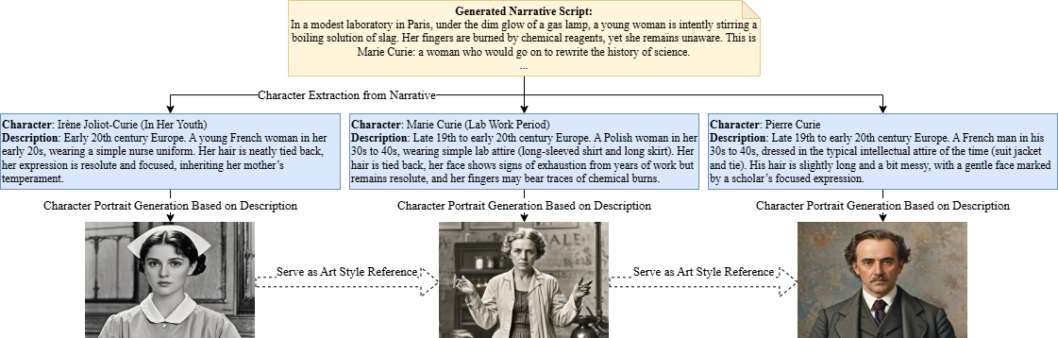
Character Grounding - Maintains consistent identity of characters
Key steps:
Stage-Aware Character Extraction
Identify the key characters and recognizes life stages or major transitions (e.g., aging, events in storyline).
Visual Reference Generation
Notes:
Now, let’s look closer at the character grounding module, which is one of key contributions to coherency in the final video. Its purpose is to maintain consistent visual identity for all characters across the video.
The first step is stage-aware character extraction. The system identifies the main characters and recognizes their life stages or major story transitions, such as aging or significant events.
The second step is visual reference generation. We create textual descriptions for each character for their specific stages, which guide the text modality, and generate portrait images using diffusion models, which guide the visual modality. These references are then used in downstream modules to ensure that characters remain visually and narratively consistent throughout the story.
In short, this module ensures that viewers always recognize the characters, even as they evolve over time.

Slide 5
Script & Scene Planning - Breakdown narrative for smooth generation
Key steps:
Hierarchical decomposition: Subscripts → Scenes → Shots
Subscript Level
Base on major events or story arcs.
Provides a high-level roadmap for the story.
Scene Level
Base on emotional tone and temporal setting.
Examples: morning vs evening, indoor vs outdoor.
Shot Level
Provide details like: Characters involved; time, location tags; Visual description
Number of shots is adaptively estimated based on narrative length.
Shot example
Character: Marie Curie (lab work period)
Visual Description: Marie Curie stands at the table, stirring a boiling solution, focused and determined.
Shot Type: Close-up, static
Emotional Highlight: Close-up captures her concentration, emphasizing dedication and persistence.
……
Notes:
Next, we decompose the narrative into a structured visual plan using our Script and Scene Planning module.
At the subscript level, the system breaks the narrative into major events or story arcs, providing a high-level roadmap for the story.
At the scene level, each subscript is split into scenes with consistent emotional tone and temporal setting, like morning versus evening or indoor versus outdoor.
Finally, at the shot level, each scene is further divided into detailed shots. Each shot includes the characters involved, spatiotemporal tags, and visual descriptions. The number of shots is adaptively estimated based on the length of the narrative, ensuring smooth pacing and transitions.
This hierarchical decomposition ensures that the video maintains a logical flow, proper pacing, and visual coherence across scenes.

Slide 6
Visual Coherence Refinement - logical consistency
Key steps:
Logical Consistency Check
Detects conflicts in actions, props, or scene elements.
Example: character age or attire matches the story context.
Prompt Refinement for Image/Video Generation
Ensures high-quality, visually coherent results
Notes:
Once the shots are planned, we refine them using the Visual Coherence Refinement module.
which includes a logical consistency check to detect potential conflicts, like whether actions or clothings align with the story setting or the character’s age.
then we refines textual prompts for image and video generation
together they ensure that each shot is visually coherent, logically consistent, and ready for high-quality multimodal generation.

Slide 7
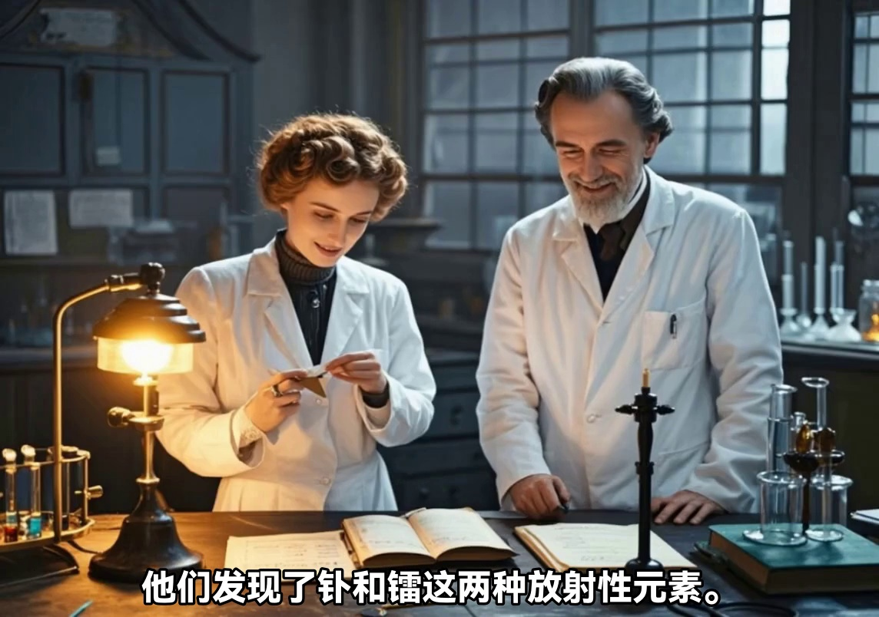
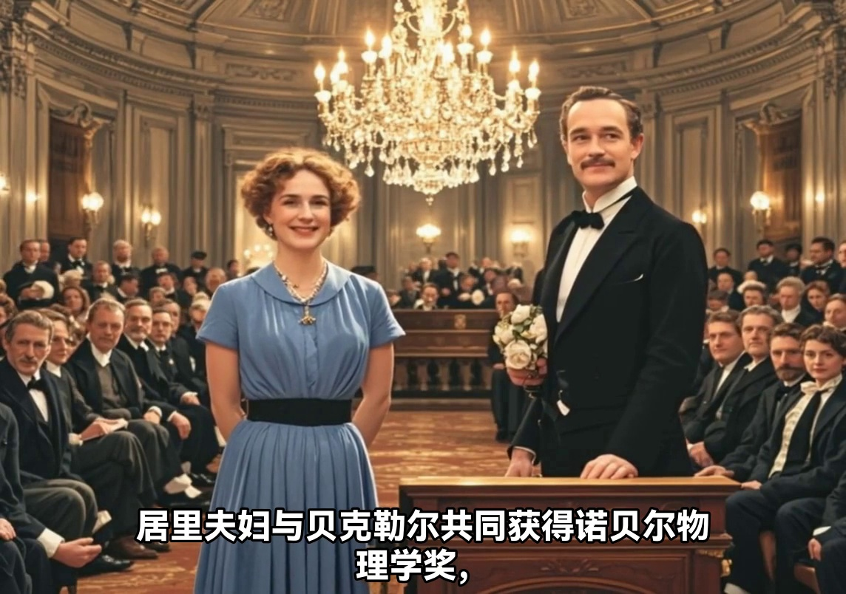
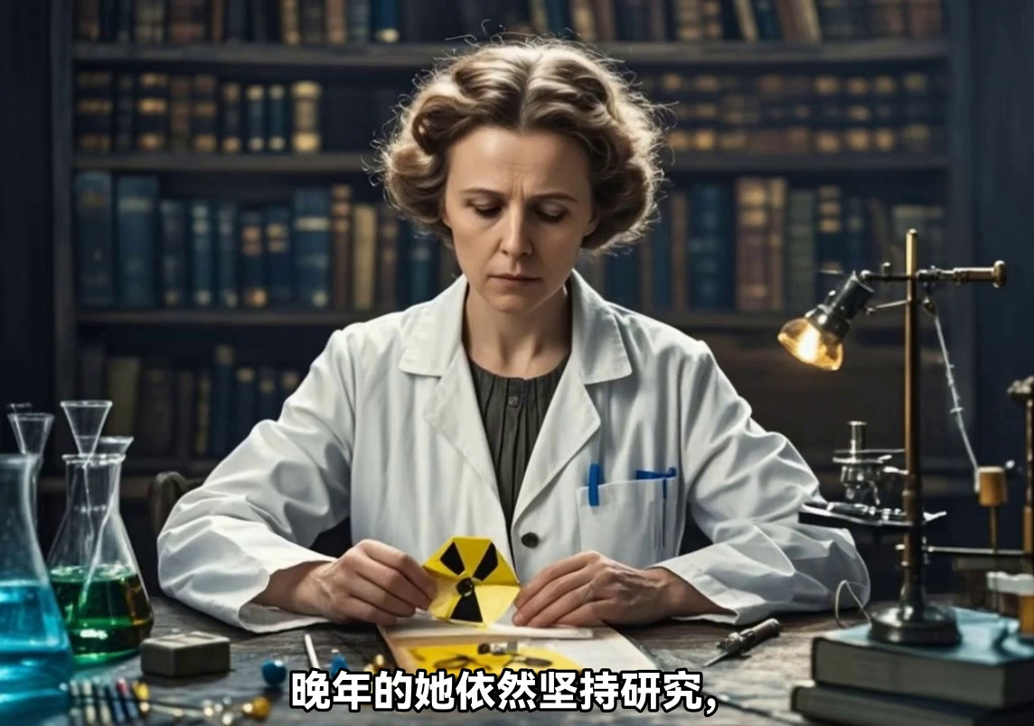
Synchronization & Video Assembly
Key steps:
Image & Audio Generation
Multimodal Assembly
Calculate audio time after TTS generation → synchronized audio and visual elements
Notes:
next comes to the Synchronization and Video Assembly module.
first to generate each modalities: including Images for each shot, convert narrative transcript to speech using TTS. after audio is generated, we take the duration for each clip to calculate duration of each clip. and then use this information as parameter while generating video clips. this process ensures the audio and visual are coherent in the final output video.
in general this module works with the upstream modules to produces a coherent, multimodal video that is visually, audibly, and narratively aligned.

Slide 8
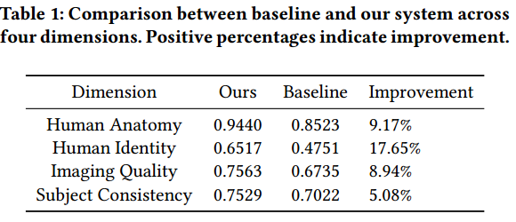
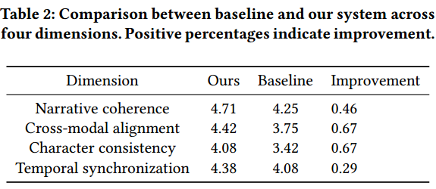
Results & Evaluation
Automatic evaluation (VBench)
Human evaluation:
Notes:
To evaluate our system, we conducted both automatic quantitative evaluation and human evaluation.
Using VBench, we measured imaging quality, human identity, anatomy, and subject consistency. Our system shows improvements of 5 to 18 percent over baselines across these dimensions.
For human evaluation, two participants rated 17 videos in scale of 1 to 5 on narrative coherence, cross-modal alignment, character consistency, and temporal synchronization. Across all dimensions, our system was consistently preferred, particularly for cross-modal alignment and character consistency.
Overall, these results show that our system effectively produces high-quality, coherent, and temporally aligned videos, outperforming baseline approaches without requiring any additional training.

Slide 9
Conclusion & Takeaways
Contributions:
Training-free hierarchical multimodal video generation.
Stage-aware character grounding.
Cross-modal alignment across text, image, audio.
Future work:
More complex narratives
web search integration
Notes:
In conclusion, our system demonstrates that it’s possible to generate coherent, engaging videos from just a single sentence without any training or fine-tuning.
our work features a hierarchical multi-agent pipeline, stage-aware character grounding modul, cross-modal alignment
Evaluation results show clear improvements over baseline methods, both in objective metrics and human preference studies.
This framework opens up exciting applications in storytelling, education, marketing, and entertainment, and in the future, we aim to handle more complex narratives and integrate external context from web search for factual correctness check and richer contents

